Slide 1
Reading Research Papers
How to read a scientific paper...

Slide 2
How many of you received a paper from your lab or found one?

Slide 3
What are your thoughts about reading research papers?

Slide 4
How long does it take you to read a research paper?

Slide 5
First, what are the parts of a paper?
Title
Abstract
Introduction
Materials/Methods
Results
Conclusion
Acknowledgements
References

Slide 6
How do you read a research paper?

Slide 7
THE THREE-PASS APPROACH
the general idea
THE FIRST PASS:
Read…
Title
Abstract
Introduction
To decide...
Do I want to read this?
Is this what I am looking for?

Slide 8
THE THREE-PASS APPROACH
THE SECOND PASS:
what the paper is about
Read…
The rest of the paper
Focus on validity
Make notes on what you do not understand
To decide...
Is this a valid paper?
Do I need to read this again?

Slide 9
THE THREE-PASS APPROACH
THE THIRD PASS:
the nitty gritty
Read…
The paper all over again
Research your notes from the second pass
To decide...
Is there another research paper to help me understand or validate this one?

Slide 10
Time to practice!

Slide 11
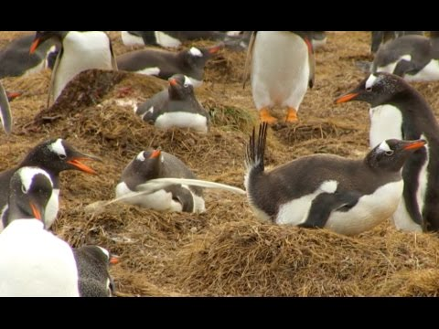
Some context
for you

